Slide 1

The Technology Value Stream
By: Colton Stone

Slide 2
WHAT IS A VALUE STEAM?
An value stream is the term applied to the series of actions taken to create and distribute a product or service which will be made available for public consumption by customers. In essence the value stream serves as an outline which details all the stages which must be hit to achieve the ideal finished concept of the product (Wong, n.d.).

Slide 3
The Technology Value Stream Lead Time vs Processing
The ‘DevOps Handbook’ speaks on the concepts of lead and processing time with the former meaning when a request to work on something is written and the latter meaning when the actual work was began.
This leads into the topic of how to best handle the building of a project in that because certain tasks can remain in line for months, it can lead to problems down the road if the team discovers that the tasks do not merge well with others upon completing them. To mitigate this the authors of the textbox highly recommend making use of a version control repository and making your code as modular and well structured as possible (Kim, 2021).

Slide 4

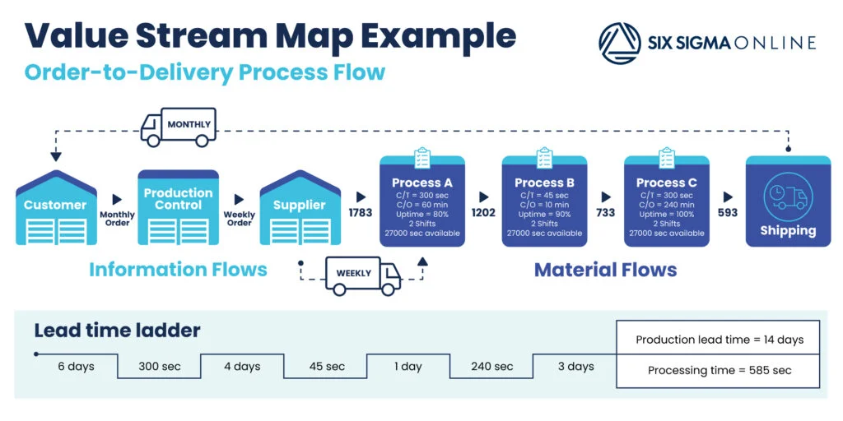
An example of how the Value Steam Process works

Slide 5
Citations
Prakash, S. (n.d.).
Value Stream Management: Explained in Plain English
https://www.devopsinstitute.com/value-stream-management-explained-in-plain-english/
Takakura, T. (n.d.).
What is Value stream management (VSM) and why is it important?
https://www.atlassian.com/agile/value-stream-management

Slide 6
Citations (Cont.)
WONG, m. (N.D.)
What is a Value Stream?
https://www.planview.com/resources/articles/what-is-a-value-stream/
Kim, Gene, et al. The DevOps Handbook, 2nd edition. IT Revolution, 2021.

